Slide 1
HEALTHCARE COST ANALYSIS
Recommendations to reduce expense in the healthcare industry
IST 687 - Introduction to Data Science
Project by : Ritik Dhame, Sai Sisira Pathakamuri,
Vedant Patil, Chuan Tse Tsai, Adrian Wagner

Slide 2
PROJECT GOALS
About our data
The data we analyzed is real life data from a Healthcare management organization. It had 7582 customers & 15 attributes such as age, BMI, children, smoker, location, education, yearly physical tests & exercising status.
Focus points:
Identifying which factors contribute to people having to spend more money on their healthcare next year.
Provide actionable insight to the HMO, in terms of how to lower their total health care costs, by providing specific recommendations on how to lower health care costs.

Slide 3
OUR APPROACH
PHASE
5
PHASE
Explore the data
Overview of Important Variables
PHASE
Conclusion and Recommendation
Load the
Data with
appropriate
libraries
Data Cleaning
and
Visual analytics
Data Modeling and Trends
6
PHASE
PHASE
PHASE

Slide 4
COMBINATIONS THAT ARE LEAST EXPENSIVE
1
Non Smoker
Without children
2
Non Smoker
Without
hypertension
Having bachelors degree
3
Non Smoker
Married
Living in urban setting
4
Non Smoker
Married
Getting yearly physical test
5
Non Smoker
Having bachelors degree
Getting yearly physical test
6
Non Smoker
Hypertension
Married

Slide 5

EXPLORATORY
DATA ANALYSIS
Understanding and visualising the data

Slide 6
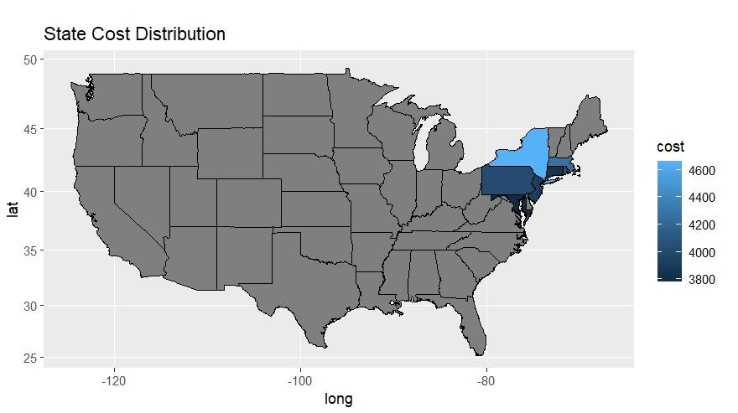
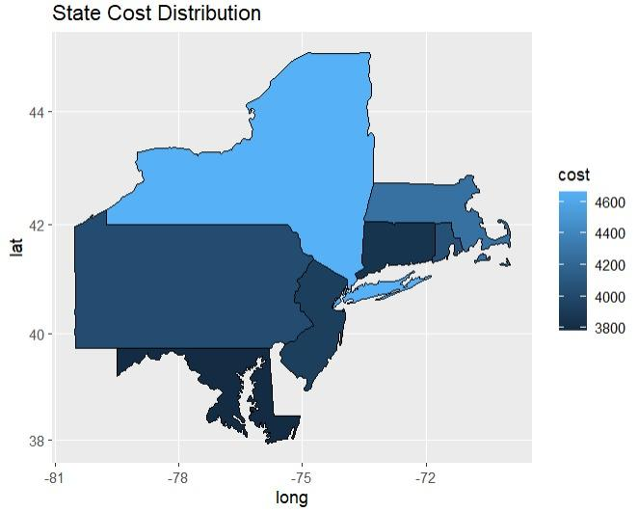
MAP TO PRESENT DATA
Pennsylvania, New York, Maryland,
Connecticut, Massachusetts, Rhode Island, New Jersey.

Slide 7
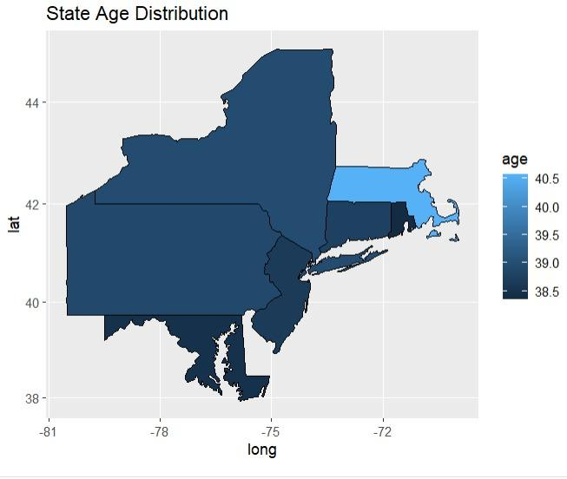
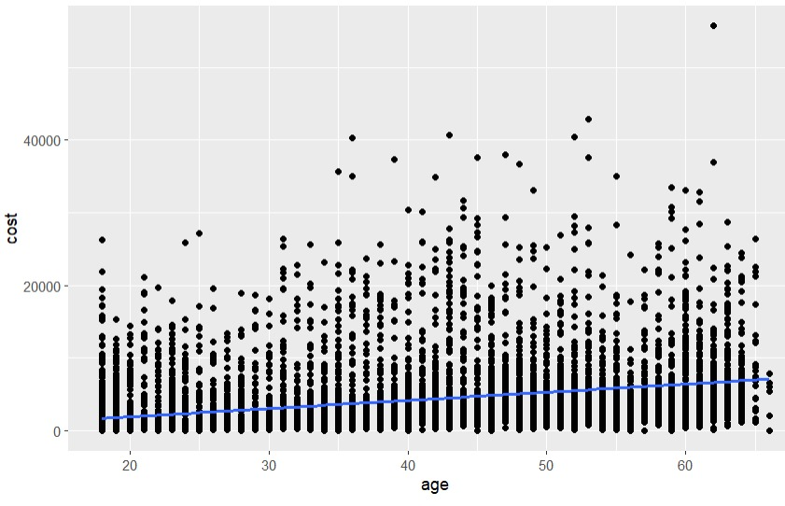
MAP TO PRESENT DATA

Slide 8
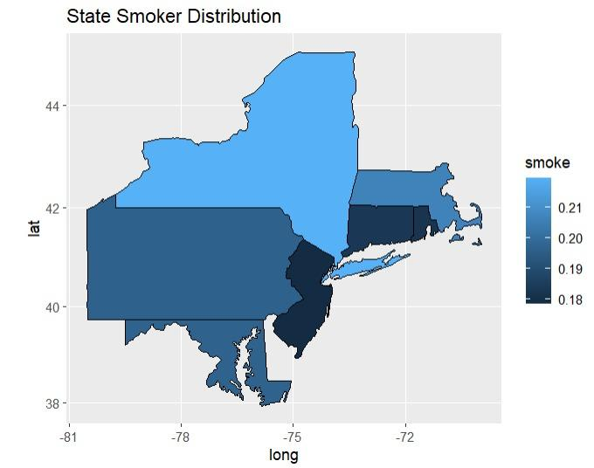
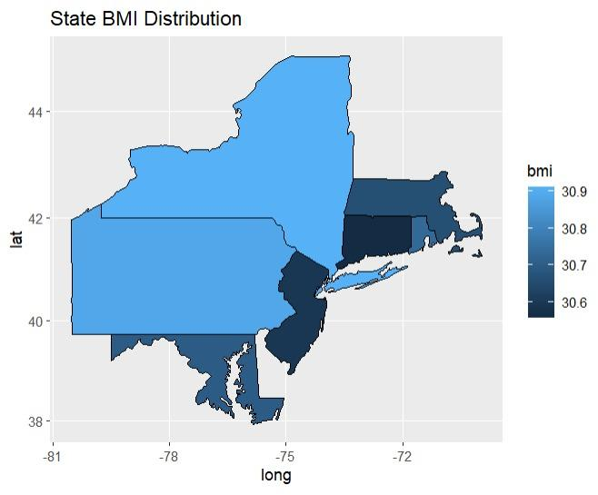
MAP TO PRESENT DATA

Slide 9
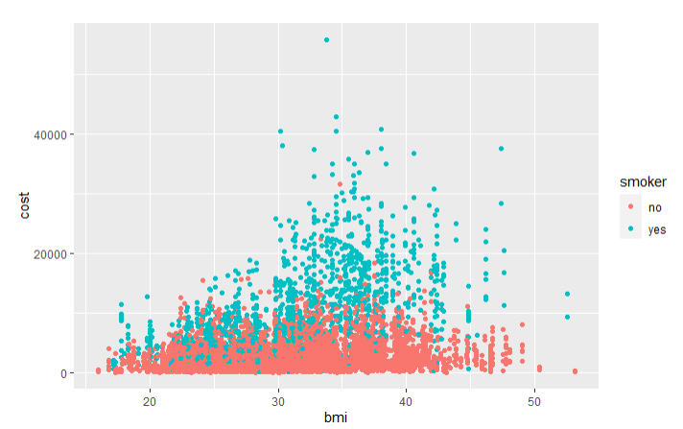
CHART TO PRESENT DATA
Analyzing smokers data
We have created a scatter plot which shows us the number of smokers and non smokers and their healthcare cost based on their BMI.
The first observation is that having a higher Body Mass Index and being a smoker increases the cost of healthcare.
As the BMI increases, the smoking plays an important role in increasing the cost.

Slide 10
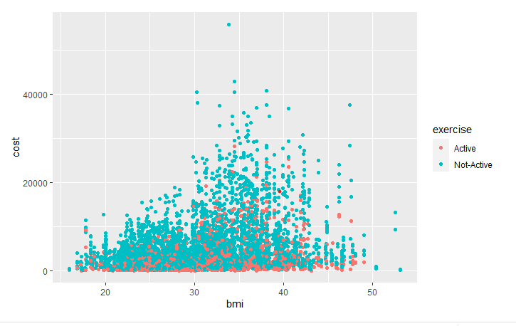
CHART TO PRESENT DATA
Analyzing active exerciser
We have created a scatter plot that shows us the number of active and non-active exercisers and their healthcare cost based on their BMI,
The first observation is that an active exerciser has a lower healthcare cost with a low BMI.
While a person not exercising has higher healthcare costs and much higher with a high BMI count.

Slide 11
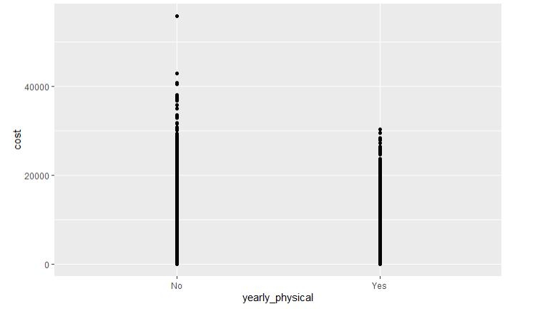
CHART TO PRESENT DATA
Analyzing regular tester
We have created a scatter plot that shows us the comparison between those who take yearly physical tests and those who do not.
The first observation is that those taking yearly physical tests have a lower healthcare cost
Those who do not take yearly physical tests have higher healthcare costs.

Slide 12
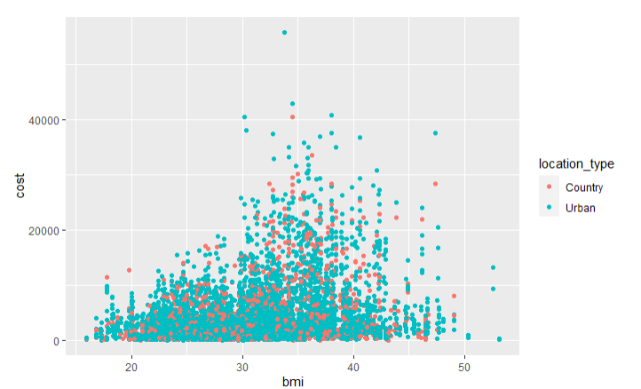
CHART TO PRESENT DATA
Location affecting the cost
We have created a scatter plot that shows the number of individuals living in the countryside and city, and their cost of healthcare based on their BMI. We can observe that
An individual living in the city has a higher cost of healthcare
Those living in the country have a lower cost of living.

Slide 13
DECIDING ON OUR MODEL
LINEAR REGRESSION
DECISION TREE
SVM MODEL
ACCURACY :42%
ACCURACY :88.06%
ACCURACY :88.06%
Factors that influenced highest accuracy were age , bmi, children, smoker, hypertension, exercise, yearly physical checkup

Slide 14
ACTIONABLE INSIGHTS
HIGH COST
LOW COST
ACTIONS
1
SMOKER STATUS
ACTIVE
NON-ACTIVE
Smoking can be avoided to reduce the
Healthcare cost.
Maintaining a lower BMI will help
Reduce the healthcare cost.
2
EXERCISER STATUS
NON-ACTIVE
ACTIVE
An active exerciser can reduce their
Healthcare cost so individual can exercise
Reduce expenditure.
Maintaining a lower BMI will help
Reduce the healthcare cost.
3
YEARLY PHYSICAL TEST
NOT TAKEN
TAKEN
Yearly physical tests can be taken
to reduce the healthcare cost
4
LOCATION
URBAN
COUNTRY
A person can consider relocation to a
country from city to reduce the healthcare
Cost.

Slide 15


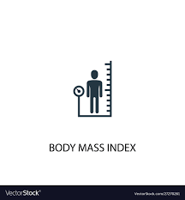
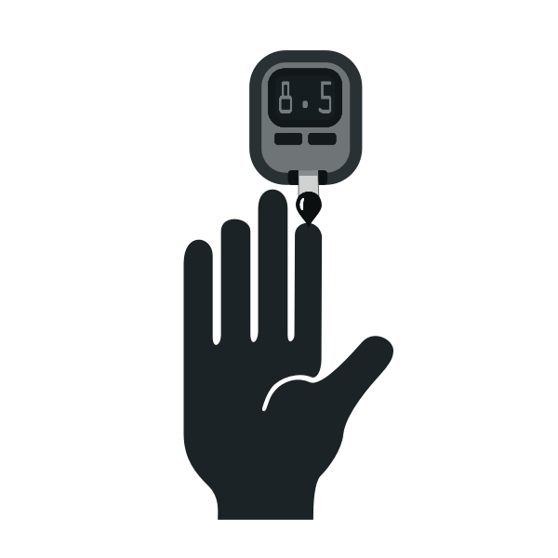
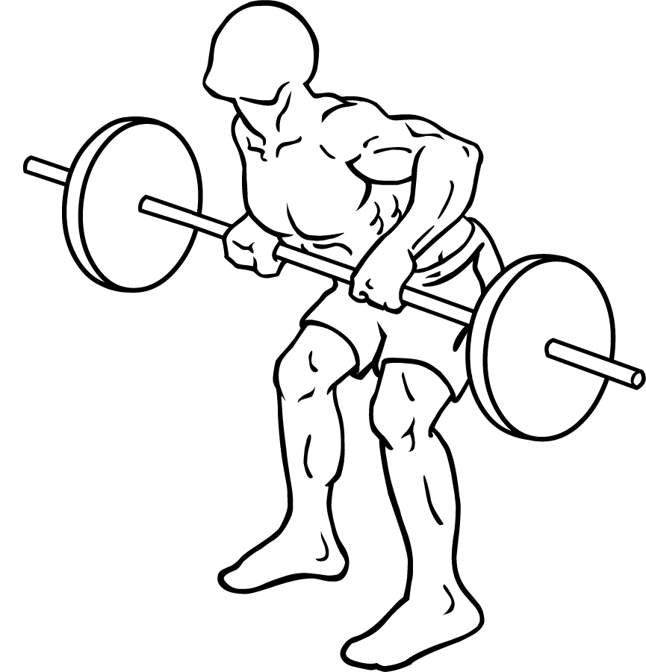
RECOMMENDATIONS
The following actions can be taken to reduce the expenses of healthcare
Consider relocation
Quit smoking
Maintaining Low BMI
Regular health check ups
Exercising regularly

Slide 16
Thanks!
Any questions or suggestions?

